Slide 1
Channel performance at mmWave communication

Slide 2
Channel performance at mmWave communication
CHANNEL PERFORMANCE AT 60 GHZ

Slide 3
CHANNEL PERFORMANCE AT 60 GHZ
Knowing the propagation characteristics and channel performance of millimeter waves is the first step to plan for a millimeter wave communication system.
While signals at lower frequency bands, such as Global System for Mobile Communications (GSM) signals, can propagate for many kilometers and more easily penetrate buildings, millimeter wave signals can only travel a few kilometers, or less, and suffer from high transmission losses in the air and solid materials.
However, these millimeter wave propagation characteristics can be very advantageous in some applications such as wireless personal area networks.
Millimeter waves can be used to establish more densely packed communication links, thus providing very efficient spectrum utilization, by means of frequency reuse, and thus they can increase the overall capacity of communication systems.

Slide 4
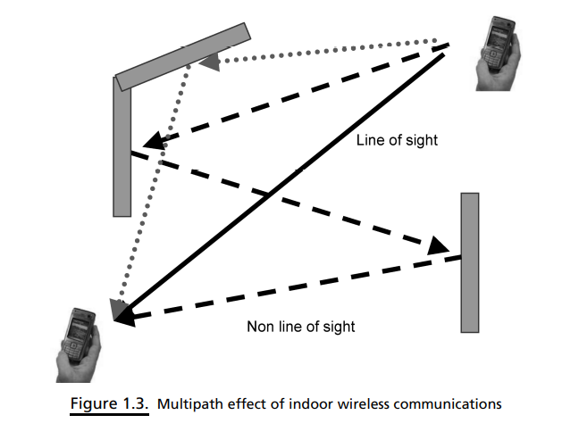
CHANNEL PERFORMANCE AT 60 GHZ
The main challenges in utilizing a 60 GHz channel can be described as follows:
High loss, as calculated from Friis equation (1.2)
Human shadowing
Non-line-of-sight propagation, which induces random fluctuations in signal level, known as multipath fading, as shown in Figure 1.3
Doppler shift is non-negligible at pedestrian velocities
Noise

Slide 5

CHANNEL PERFORMANCE AT 60 GHZ
The Federal Communications Commission (FCC) limits the equivalent isotropically radiated power (EIRP) of a 60 GHz communication link to + 40 dBm
Transmitter’s power and path loss can be limiting factors for a high-speed wireless link. However, antenna directivity can be used to increase the power gain in the desired direction.
Assuming a simple line-of-sight free-space communication link, where both the received power P_{RX} and noise figure for the receiving system are 10 dBm and 10 dB, respectively, three different lengths are used for the distance R between the transmitter and receiver: 10, 15, and 20 m.
Also, if we assume single omnidirectional antennas at the transmitter and receiver, the received power P_{RX} at a distance R decreases with an increase in frequency, and a 10-dB human shadowing loss is assumed for a system operating at 60 GHz

Slide 6
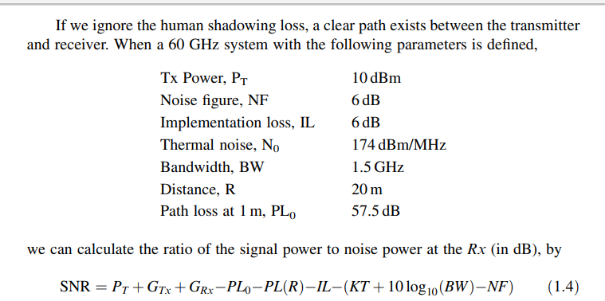
CHANNEL PERFORMANCE AT 60 GHZ
If we ignore the human shadowing loss, a clear path exists between the transmitter and receiver. When a 60 GHz system with the following parameters is defined.

Slide 7
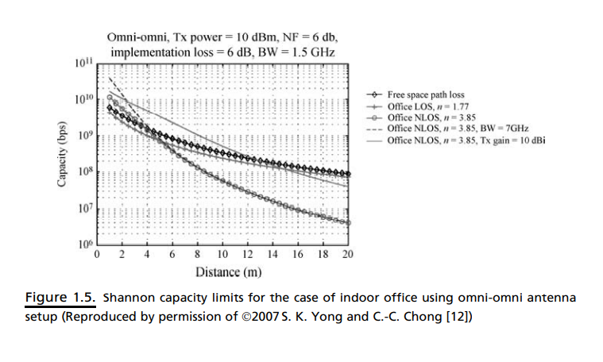
CHANNEL PERFORMANCE AT 60 GHZ
where GTx and GRx denote the transmitting and receiving antenna gains, respectively, and PTx denotes the transmitter power.
Inserting Equation (1.4) into the Shannon capacity formula of Equation (1.3), the maximum achievable capacity in AWGN can be computed.
Figure 1.5 shows the Shannon capacity limit of an indoor office for LOS and non-LOS (NLOS) cases, using an omni-omni antenna setup [12]. It was found that for the LOS condition, data rate can go up to 5 Gbps. On the other hand, the operating distance for an NLOS condition is limited to below 3 m, although the NLOS capacity decreases more drastically as a function of distance.
To improve the capacity for a given operating distance, one can either increase the bandwidth or signal-to-noise ratio (SNR) or both. It can also be seen from Figure 1.5 that increasing the bandwidth used by more than 4 times only significantly improves the capacity for distances below 5 m.

Slide 8
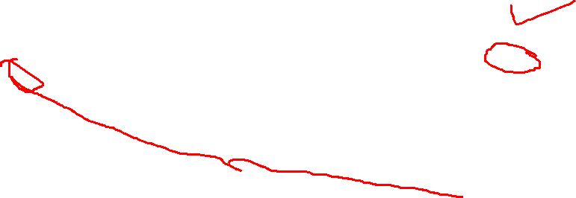

Slide 9
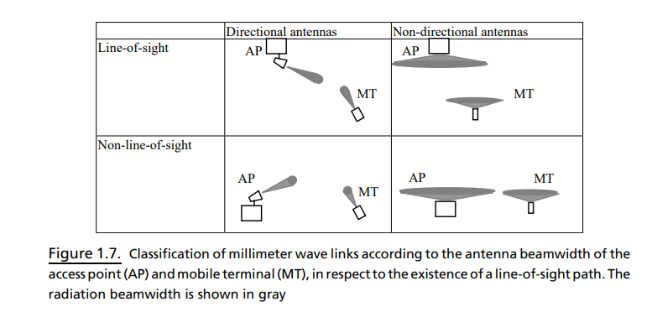
Directional antennas are required for Gigabit wireless communications.
We can have different configurations for the access points (AP) and the mobile terminal (MT) based on different applications, as shown in Figure 1.7.

Slide 10
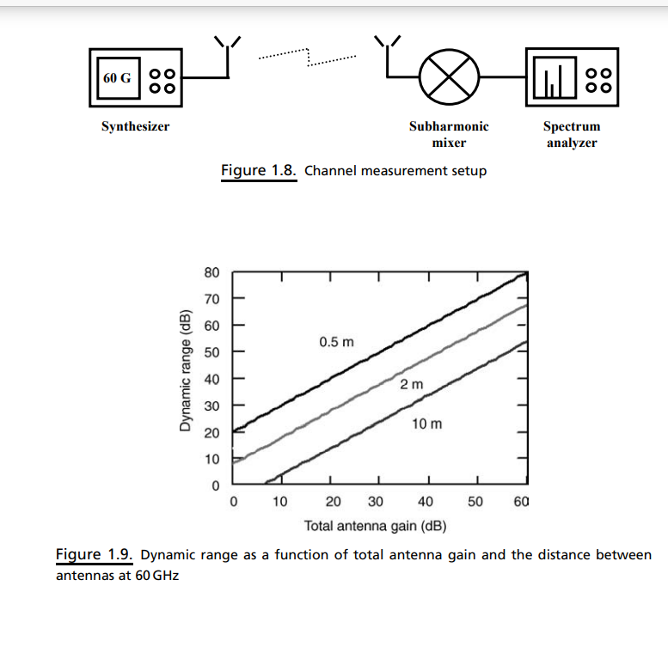
Channel Measurement
Considering the 60 GHz measurement setup shown in Figure 1.8, the synthesizer has a maximum output power of 0 dBm at 65 GHz. The coaxial cables have a maximum transmission loss of 6.2 dB/m at 60 GHz.
The conversion loss of the subharmonic mixer is assumed to be 40 dB and its noise figure is 40 dB, while voltage standing wave ratio (VSWR) is 2.6:1. The noise floor for the spectrum analyzer is assumed to be 130 dBm

